Slide 1
Coding seminar
28/07/2023
Lesson 4: Brief introduction to machine learning
Ikue Hirata, PhD
ikue.hirata@iit.it

Slide 2
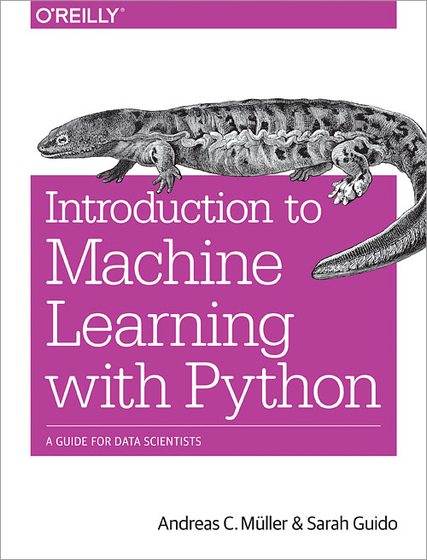
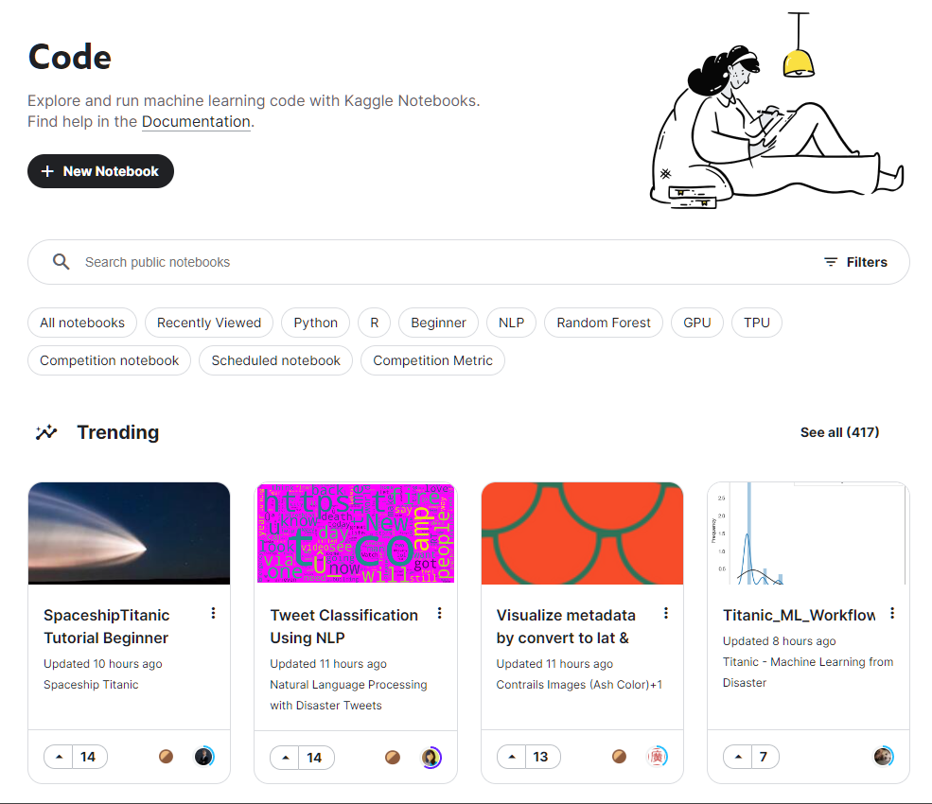
Textbooks/references
Scikit-learn website
LightGBM website
TensorFlow website
PyTorch website
Kaggle notebooks
Introduction to Machine Learning with Python
Best for those who already know numpy
Covering basics
Many examples and minimum codes
These slides heavily relies on the material from the author’s GitHub

Slide 3

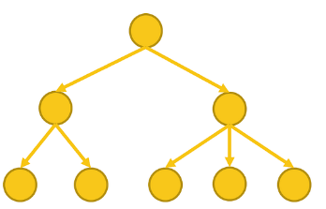

Machine learning procedure
Model definition
Training
Evaluation
What’s the prediction of these data?
Use this model
Fit model to these data
Yes, sir
Yes, sir
Here, sir!
Model | Hyperparameters
Decision tree Random forest SVM Neural network | Learning rate Randomness Early stopping # of nodes # of samples per node
Metric | Optimizer
binary_logloss L1/L2 RMSE MAE RMSLE AUC | SGD NAG RMSProp Adam
Eval. metric | Data split | In-depth
binary_logloss L1/L2 RMSE MAE RMSLE AUC | CV | Feature importance SHAP

Slide 4


2 direction to use
Prediction
Analysis
Past
Future
Which factor is critical?

Slide 5




Supervised learning
Training data
Label
Test data
Cat
Dog
Cat
Cat
Cat
Cat
Dog
Dog
Cat
Dog
Cat
Dog
Dog
Dog
Dog
Cat
Cat!
Dog
Dog
Dog
Cat
Cat

Slide 6










Unsupervised learning
These look like same category…

Slide 7
Classification
Categorical label
int
Training data
Test data
0
1
0
0
0
0
1
1
0
1
0
1
1
1
1
0
0!
1
1
1
0
0

Slide 8

Regression
Numerical label
float
300k
400k
240k
800k
800k
500k
450k
1M
680k
620k
350k
Last one is € 500k…?

Slide 9
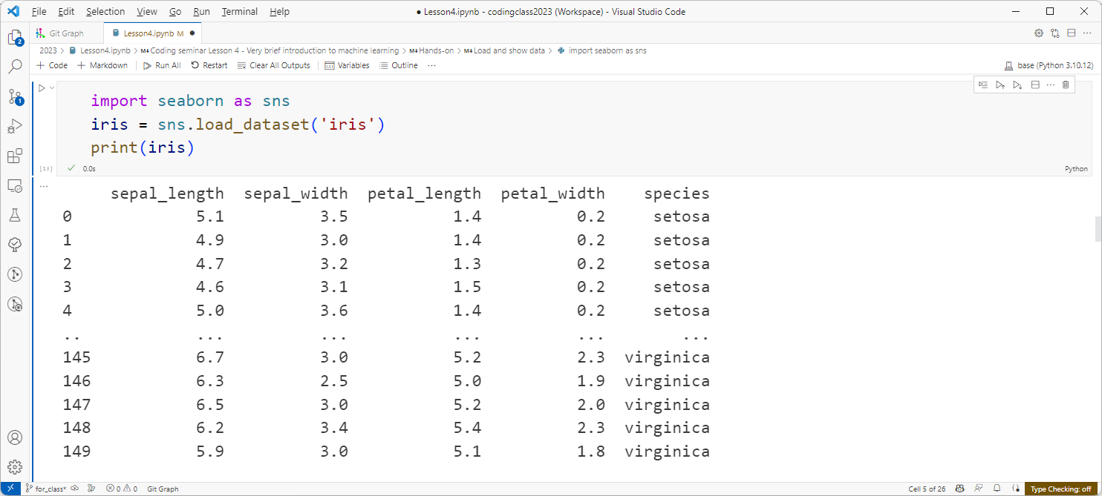
Hands-on machine learning: iris

Slide 10
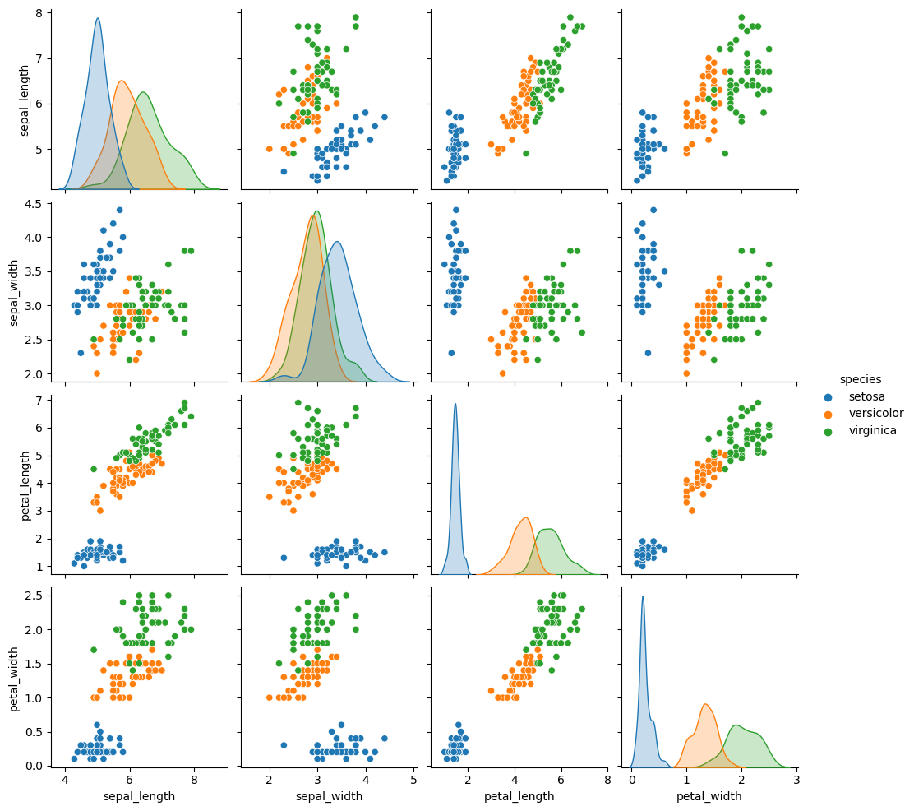
Visualize whole database

Slide 11
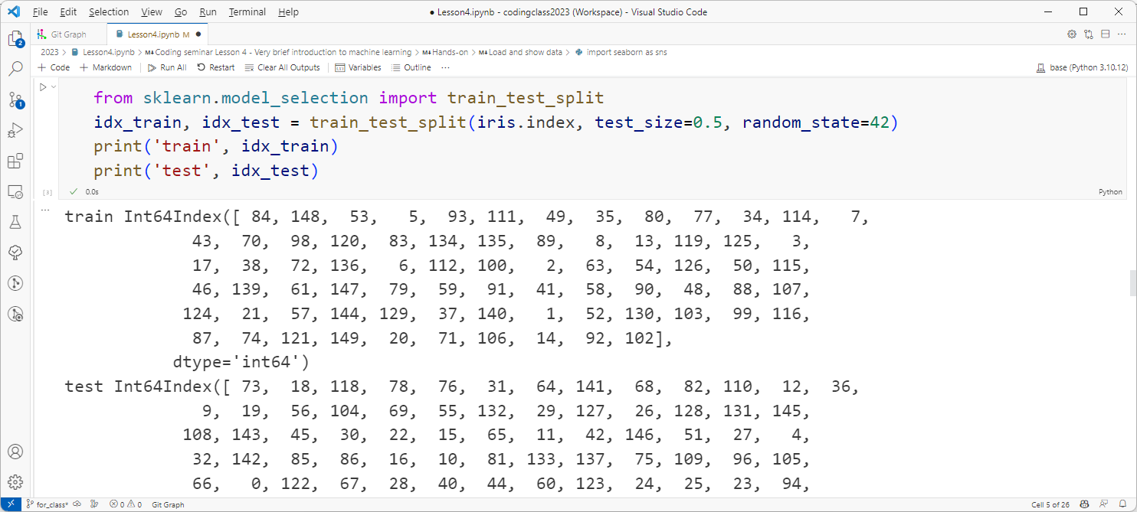

Train test split
Whole dataset
Train
Test
Train
Test
Test

Slide 12
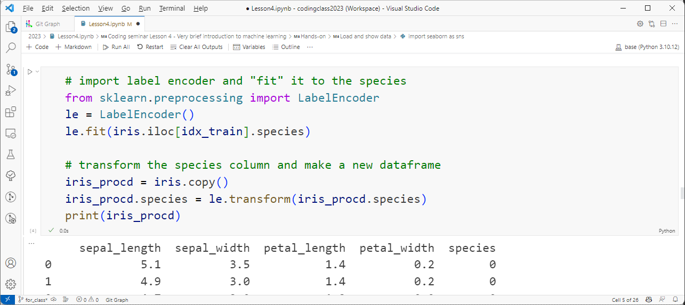



Label transform

Slide 13
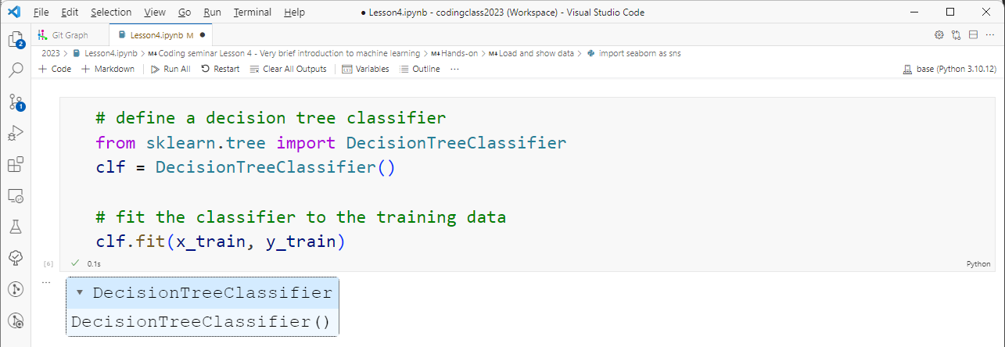
Define model and fit

Slide 14
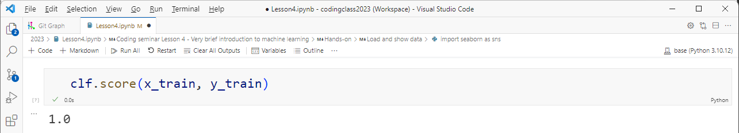
Model accuracy to train data

Slide 15
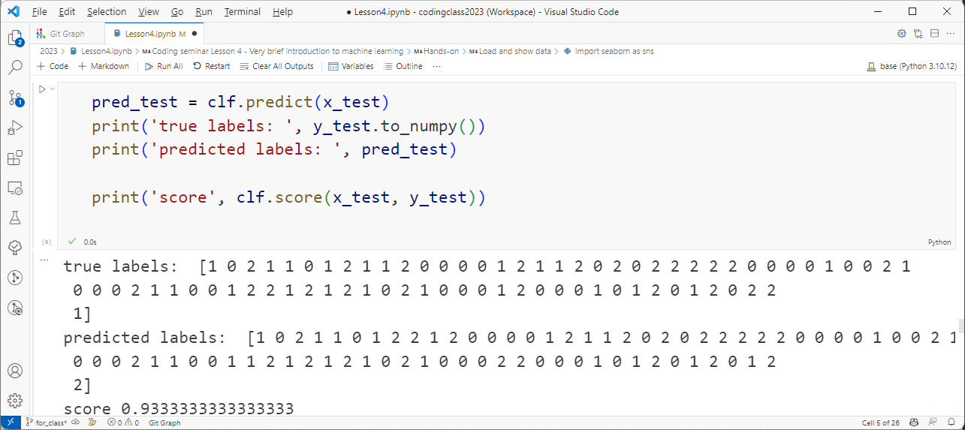
Prediction with test data

Slide 16
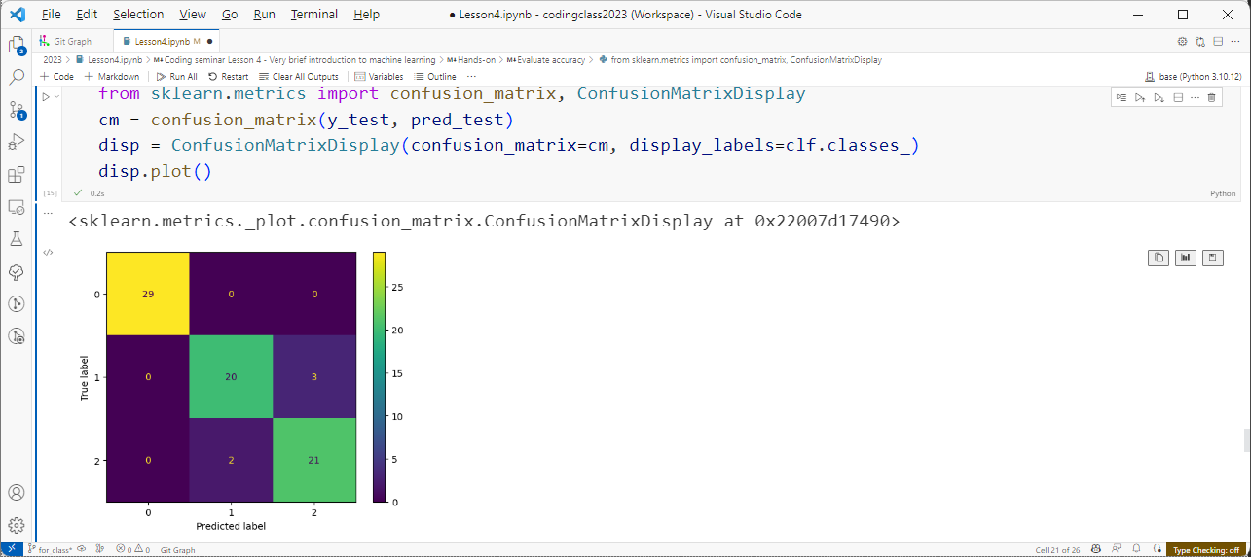
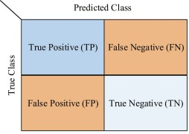


Confusion matrix / visualization

Slide 17
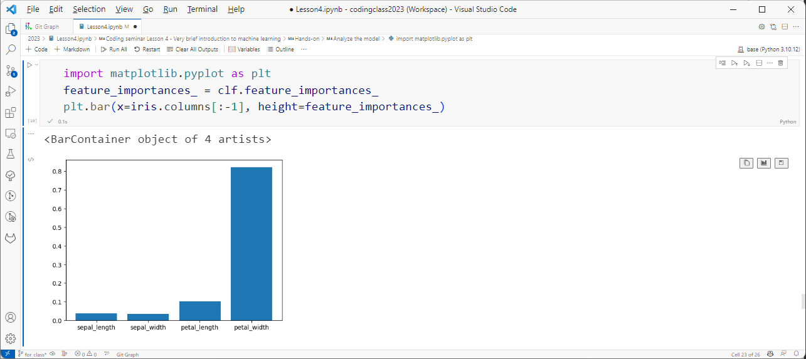
Model analysis: feature importance

Slide 18
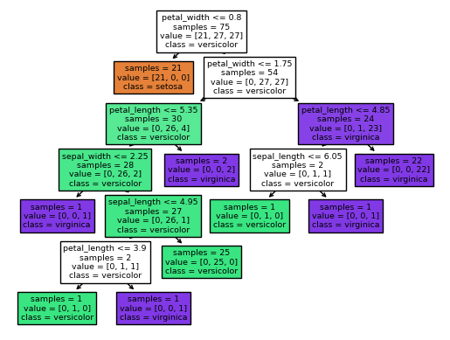
Model analysis: plot tree

Slide 19
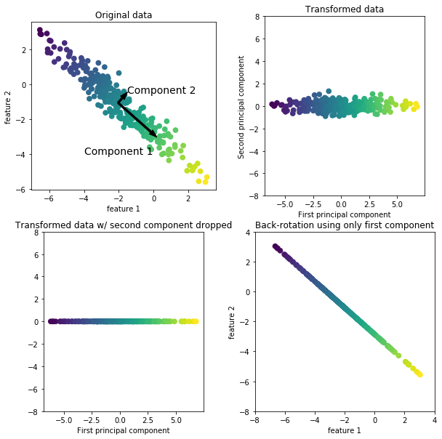
Feature engineering: PCA
Reduce the dimension for the data to better explain themselves
https://github.com/amueller/introduction_to_ml_with_python/blob/master/03-unsupervised-learning.ipynb

Slide 20







Other models
Gradient boosting-based model
Neural network (deep learning)
https://scikit-learn.org/stable/tutorial/machine_learning_map/index.html

Slide 21
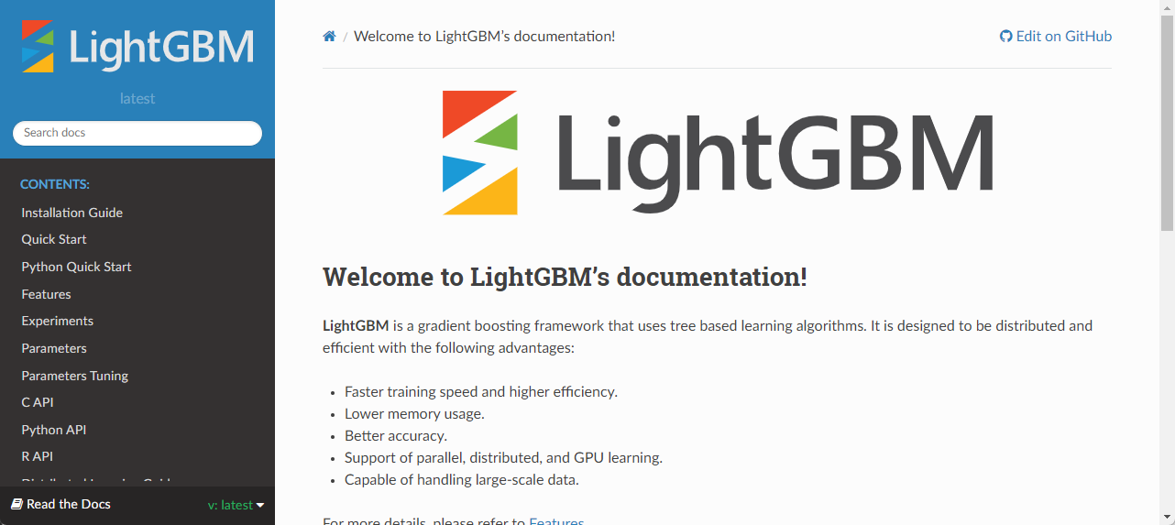
LightGBM
https://lightgbm.readthedocs.io/en/latest/index.html

Slide 22
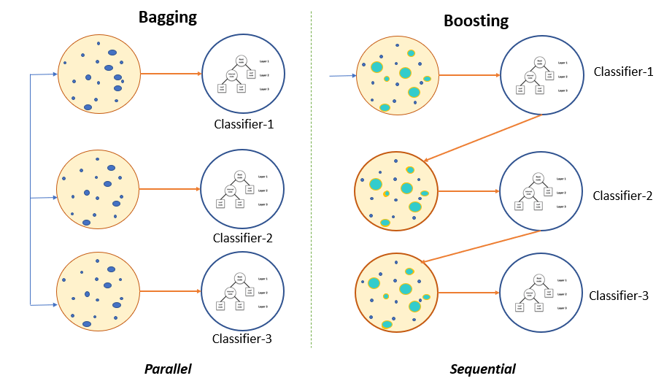
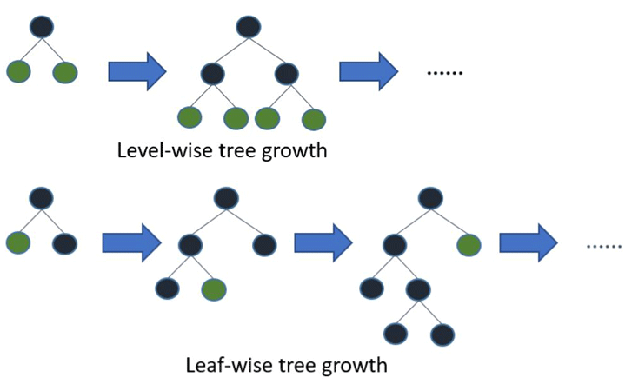
What is this?
Use multiple trees
Boosting: new tree is based on previous tree
Leaf-wise growth
https://www.pluralsight.com/guides/ ensemble-methods:-bagging-versus-boosting
https://rohitgr7.github.io/lightgbm-another-gradient-boosting/

Slide 23
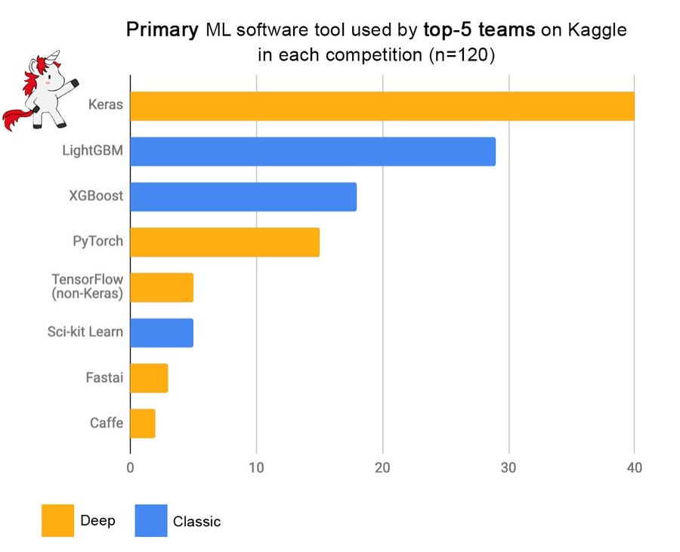
Strong, simple to use, flexible
https://twitter.com/fchollet/status/1113476428249464833

Slide 24
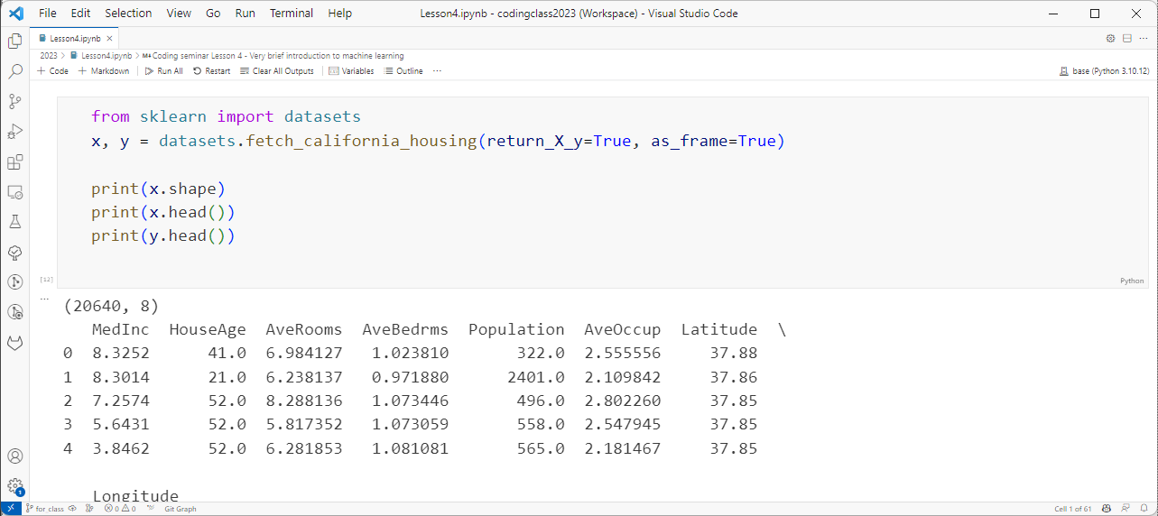
Demo: California house price data

Slide 25
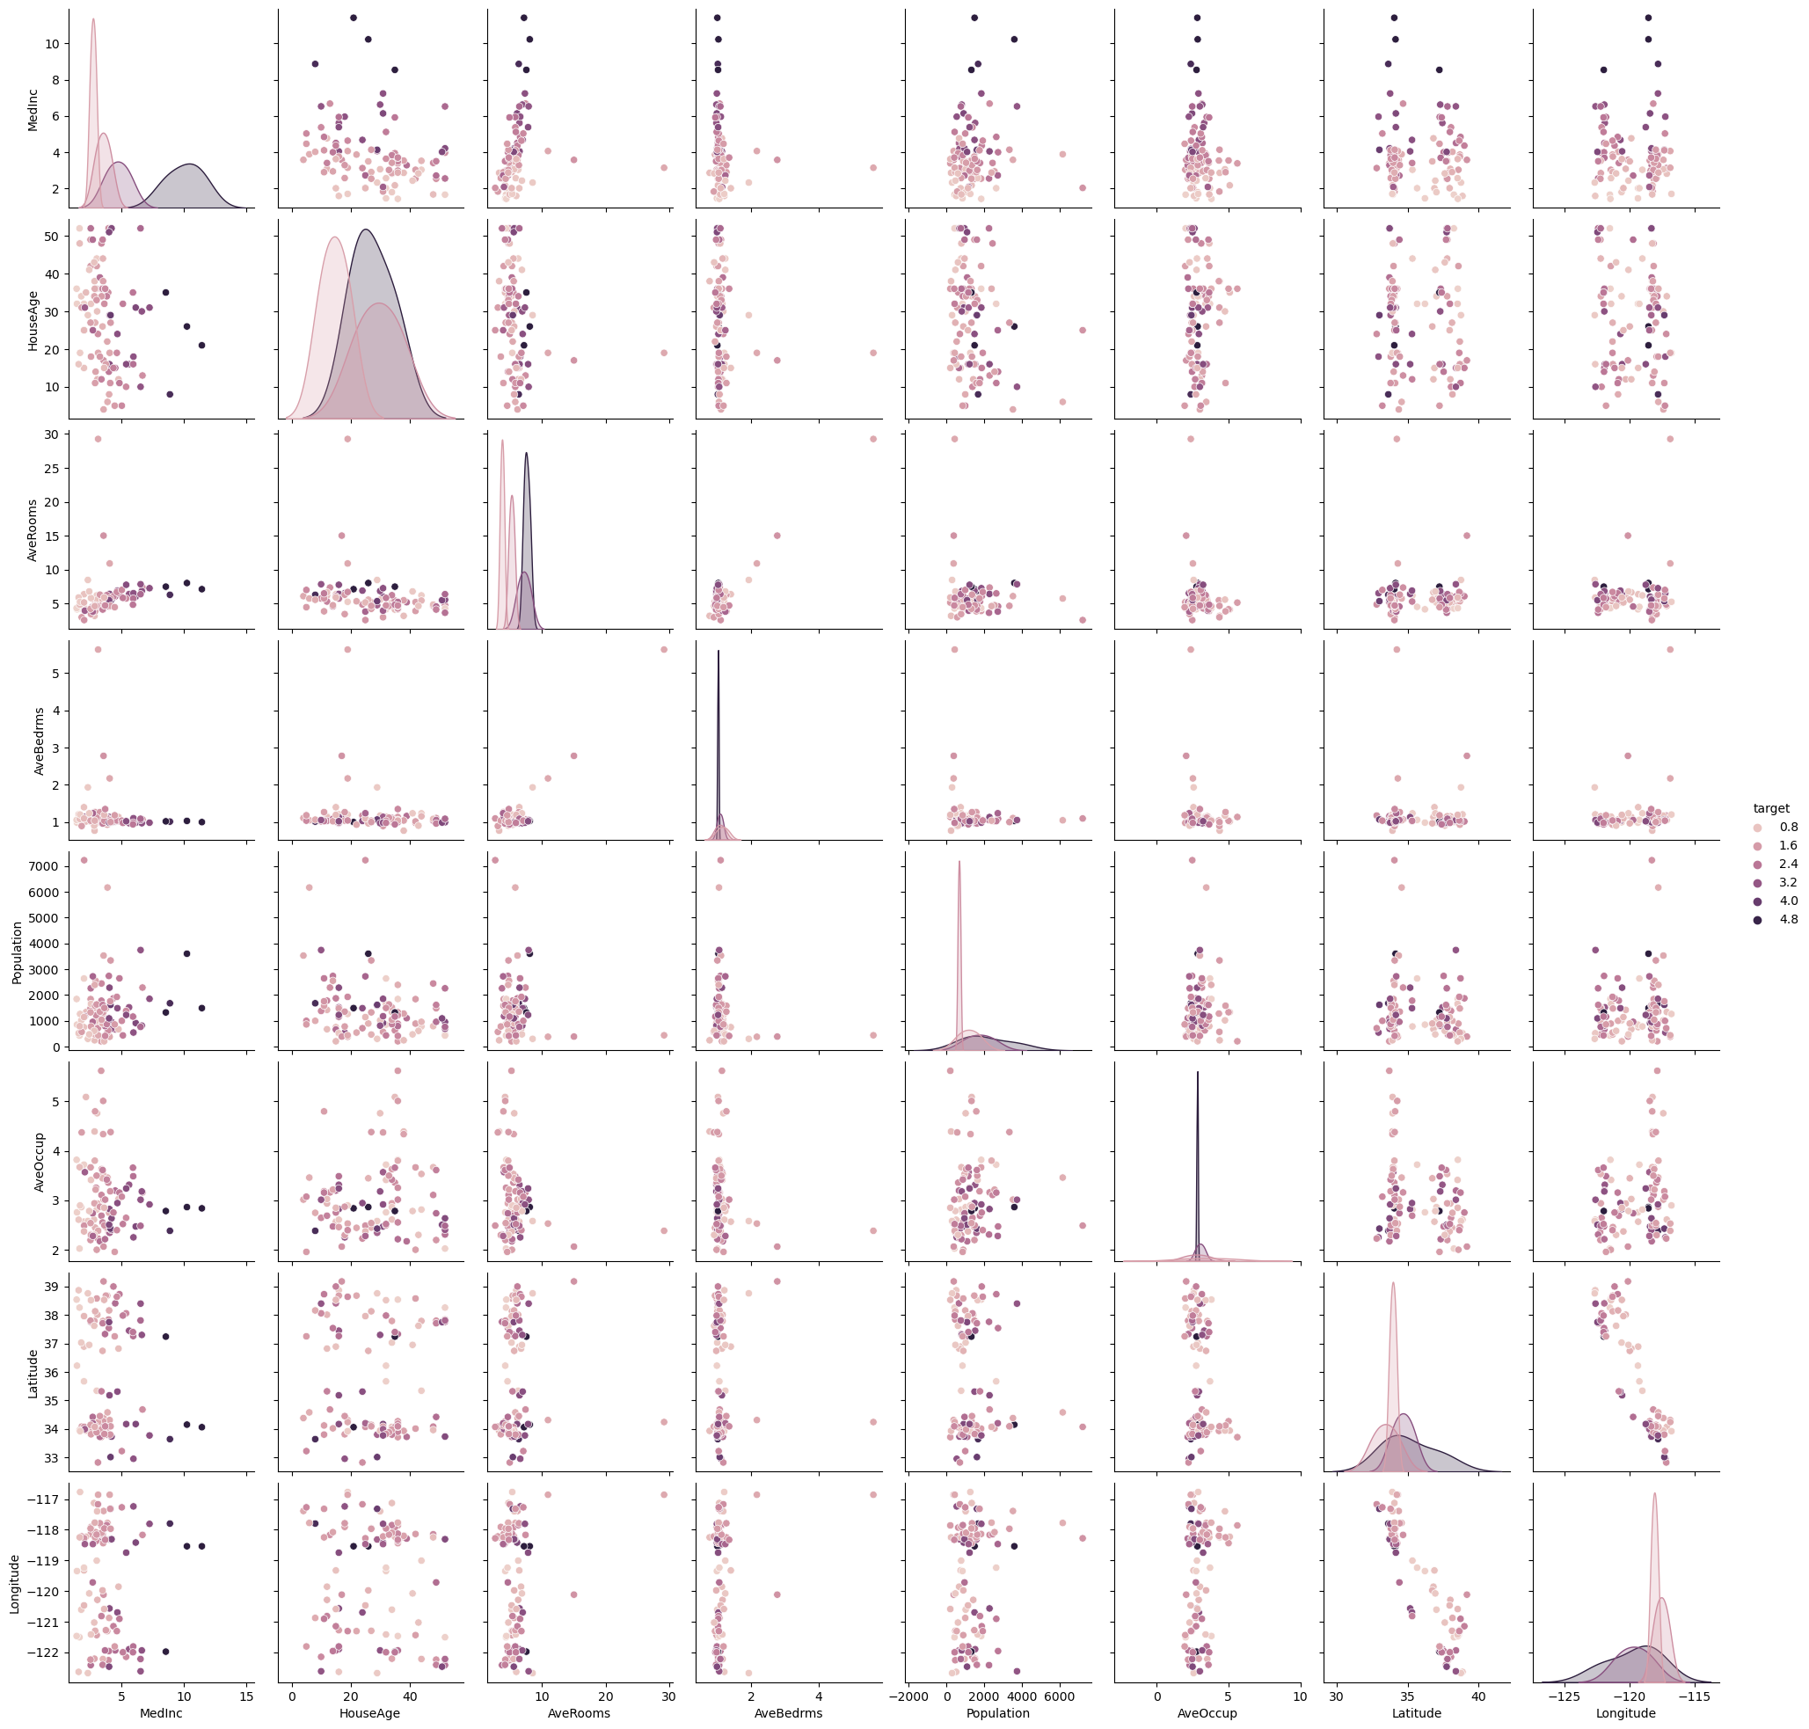
Visualization

Slide 26
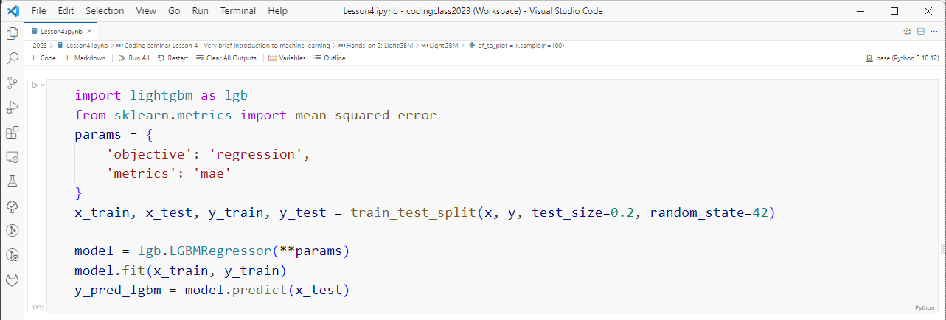
Set up the model, train
Model parameters
Define model
Fit
Predict

Slide 27
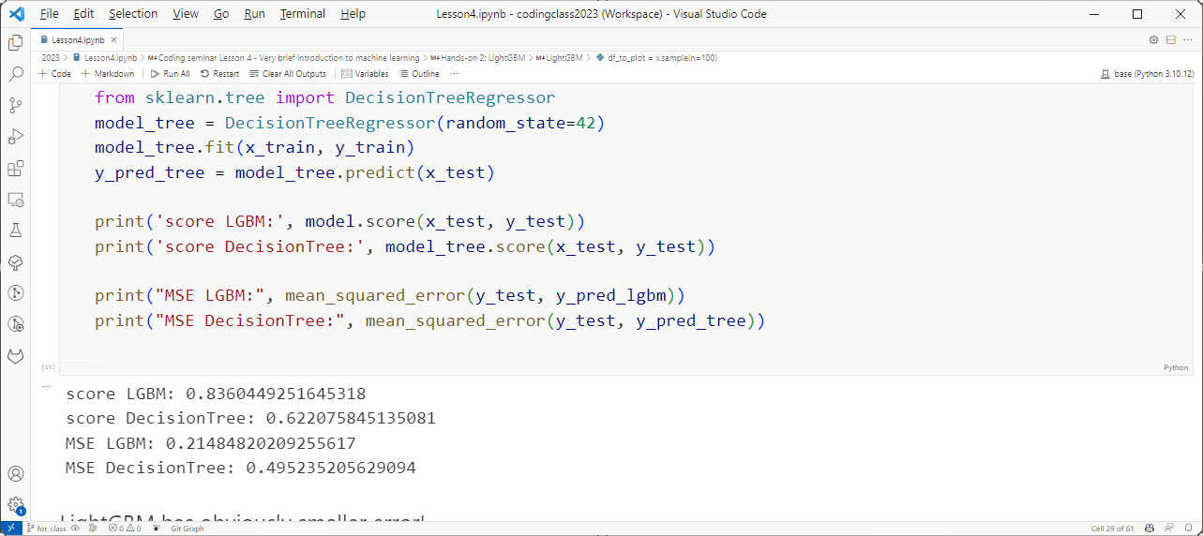
Score LGBM vs. DecisionTree

Slide 28
Hyperparameters
Bagging rate
Boosting rate
How many times?
https://www.pluralsight.com/guides/ensemble-methods:-bagging-versus-boosting

Slide 29
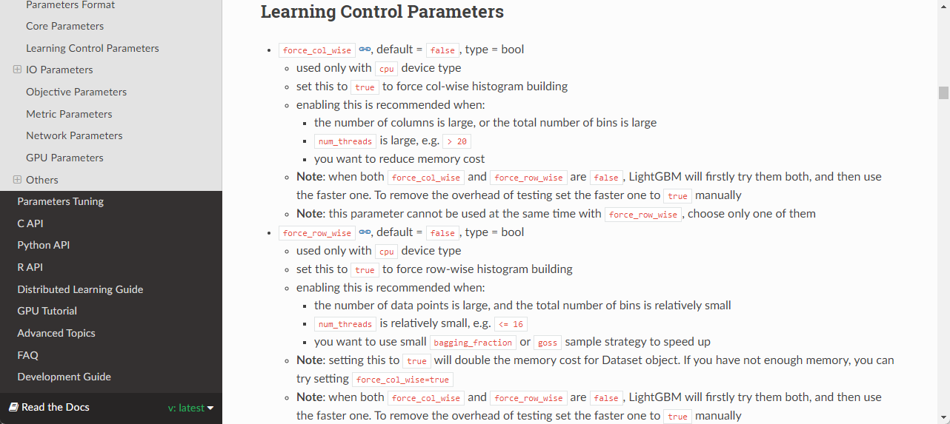
Lot of hyperparameters…

Slide 30
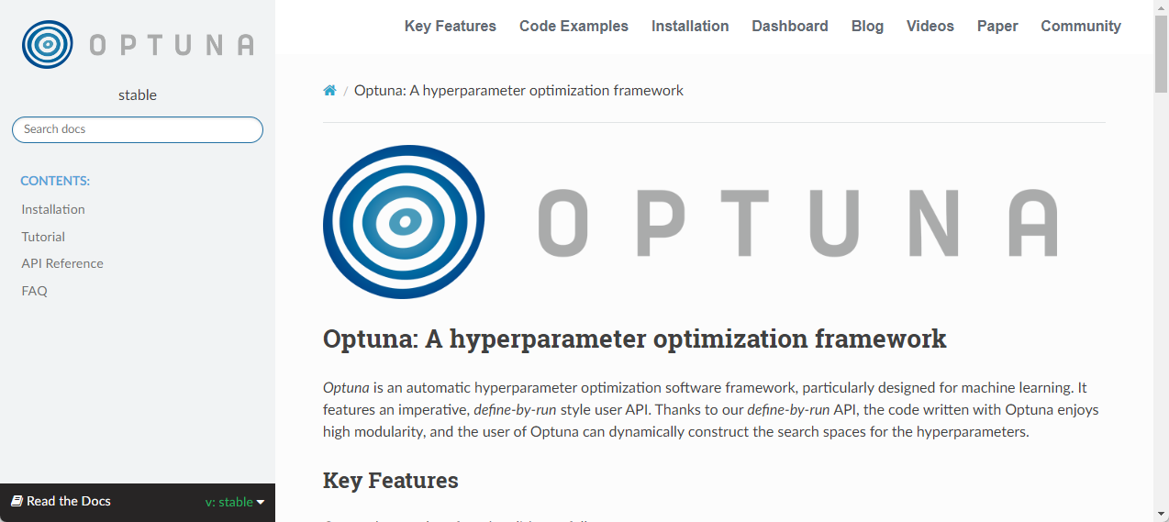
Hyperparameter tuning
https://optuna.readthedocs.io/en/stable/index.html

Slide 31
Validation dataset
Train
Test
Train
Val
Test

Slide 32
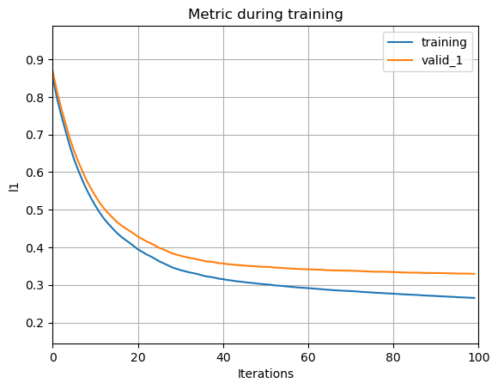
Learning curve
https://www.pluralsight.com/guides/ensemble-methods:-bagging-versus-boosting

Slide 33

Cross validation
https://scikit-learn.org/stable/modules/cross_validation.html

Slide 34
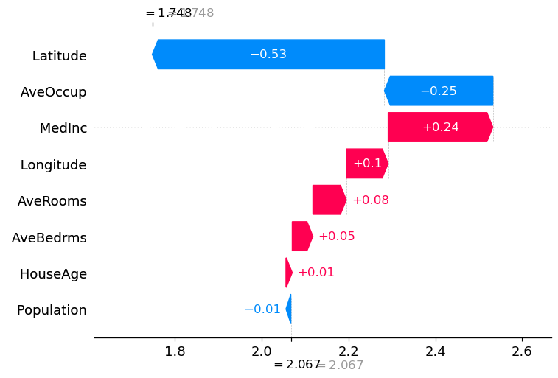
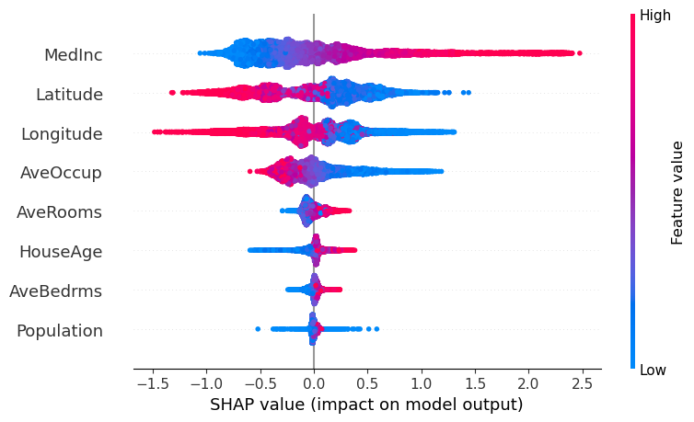
SHAP
Very strong visualization tool to see which feature works how
https://shap.readthedocs.io/en/latest/index.html

Slide 35
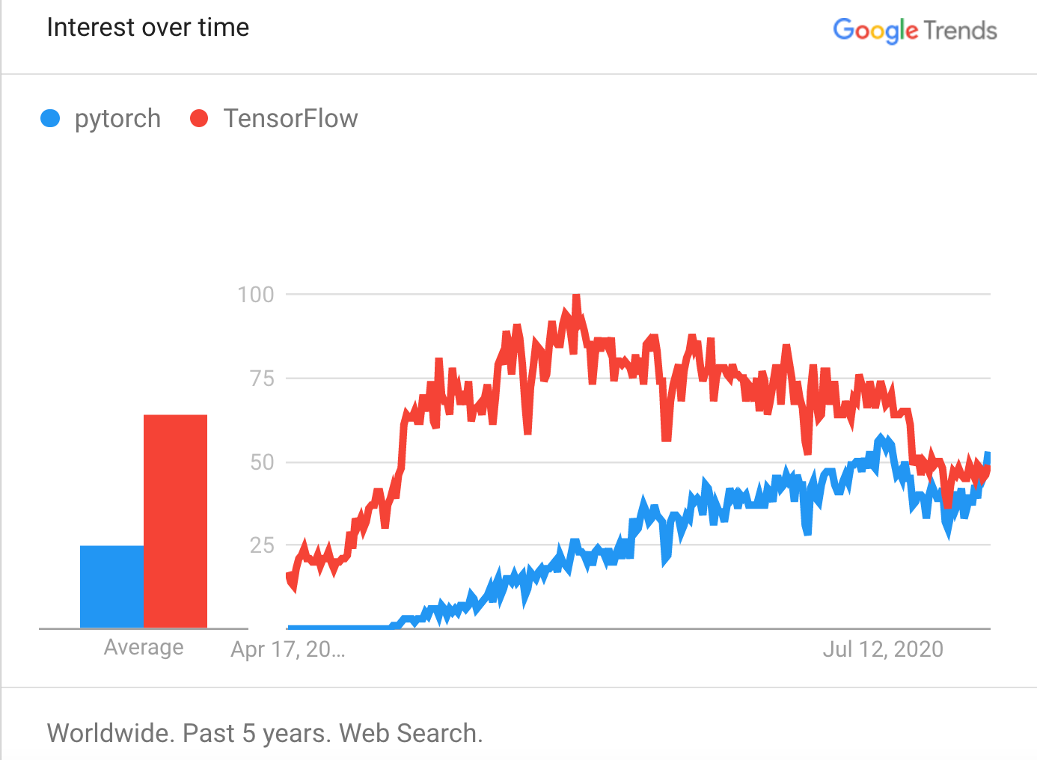
Neural network: PyTorch / TensorFlow
https://www.imaginarycloud.com/blog/pytorch-vs-tensorflow/

Slide 36
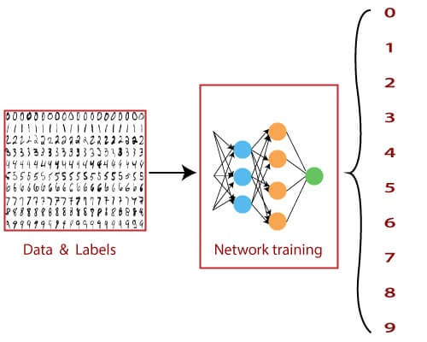
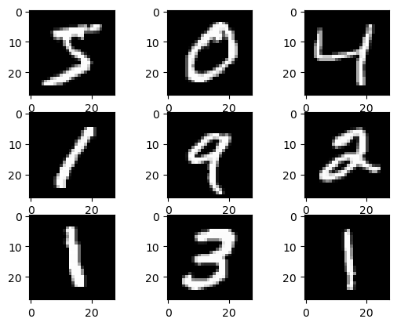
Hands-on: MNIST
https://www.javatpoint.com/tensorflow-mnist-dataset-in-cnn

Slide 37
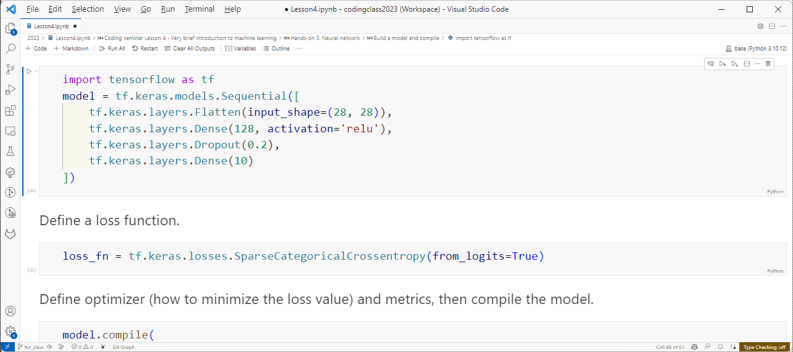
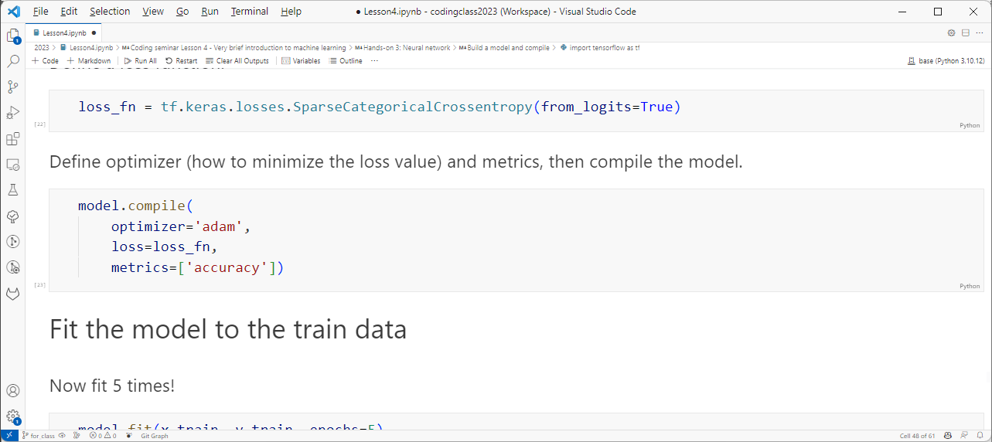
Build a model, set functions, compile
https://www.tensorflow.org/tutorials/quickstart/beginner

Slide 38
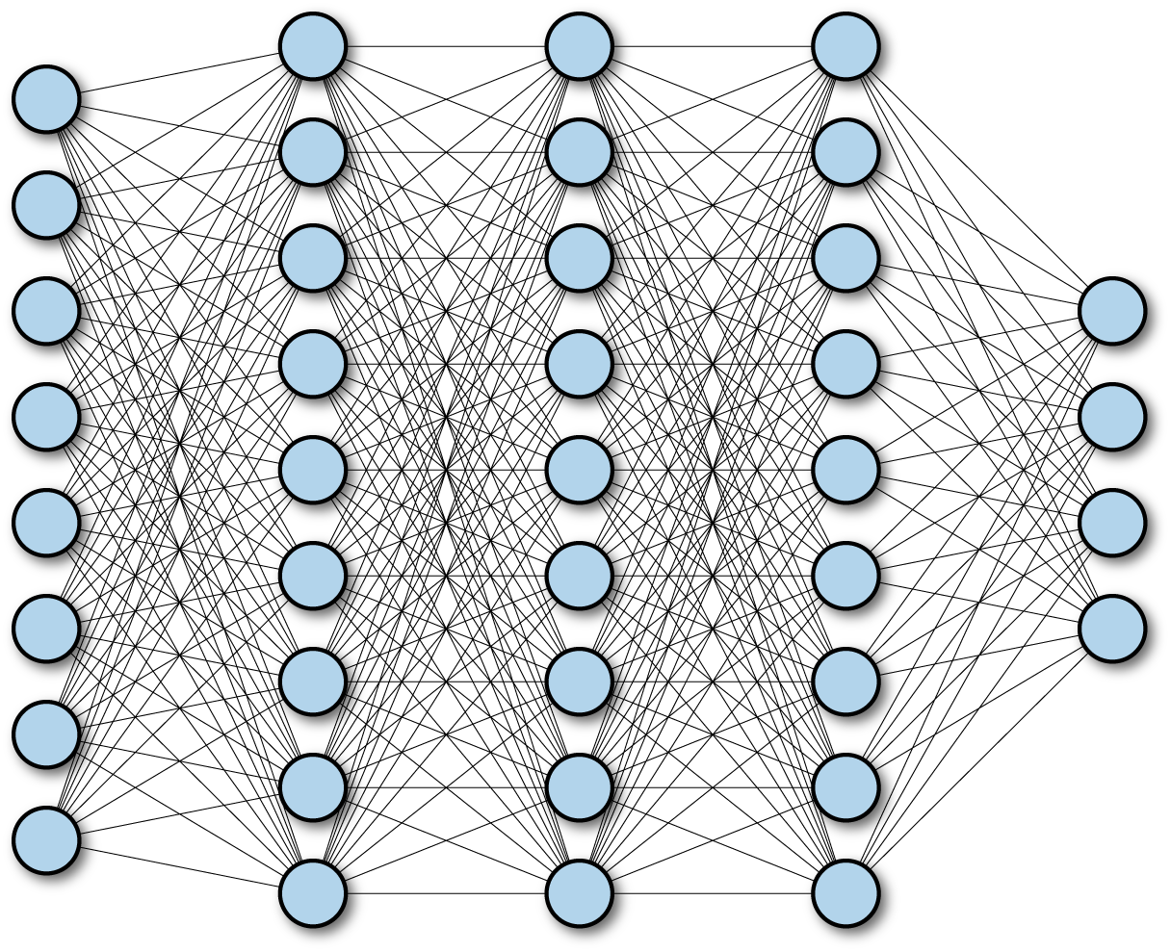
What are these layers?
Input
Probability
[0 0 0 0 0 1 0 0 0 0]
Input layer:
Flatten 28 x 28 input to 784-dimensional vector
Hidden layer 1:
Activate 784 elements into 128 elements using ReLU function
Hidden layer 2:
Removes 20% of elements
Output layer:
Activate 102 elements into 10 elements using ReLU function

Slide 39
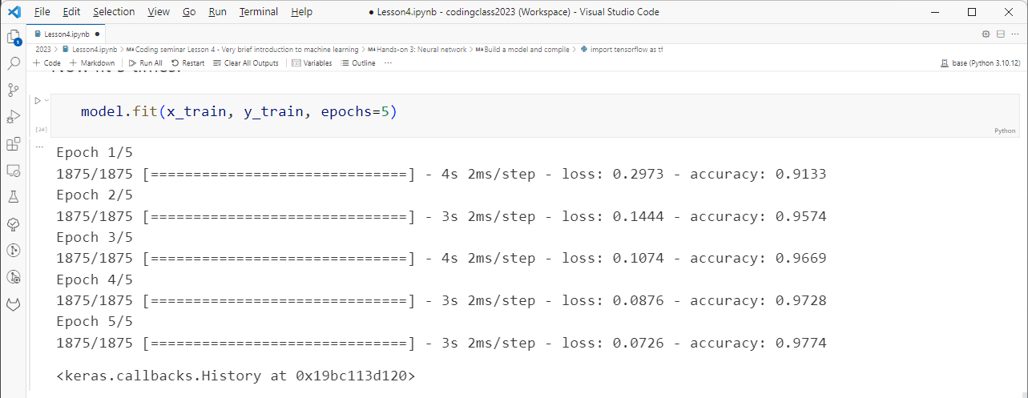
Fit

Slide 40
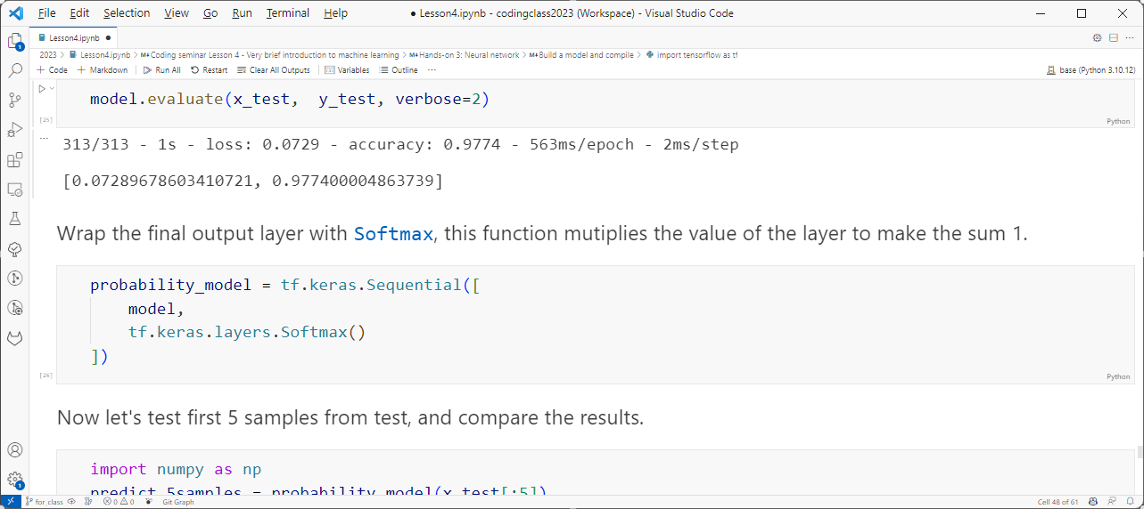
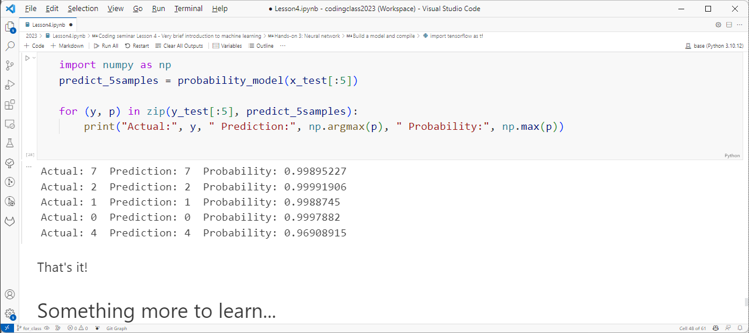
Evaluate

Slide 41
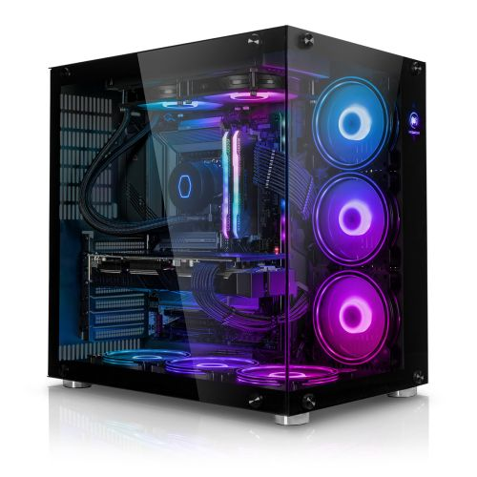

Do you need more power?
Expensive
Bulky
Consumes a lot of power
Needs maintenance
Free/paid
Cloud base
External resource
Limited time/memory

Slide 42
More keywords…
Other models
Hyperparameter tuning
TensorBoard
CNN, LSTM
Transfer learning

Slide 43
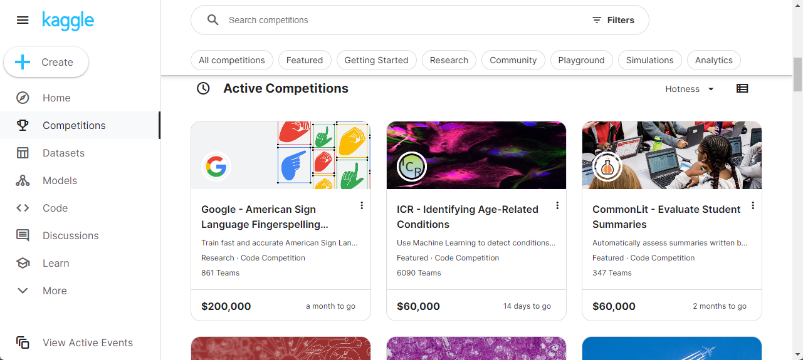
Kaggle
https://www.kaggle.com/

